Slide 1

GIT vs X….

Slide 2
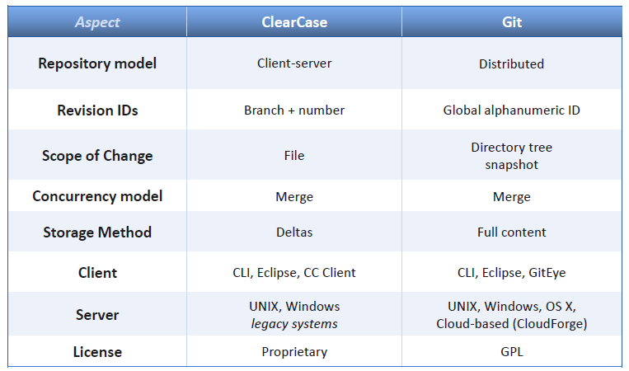
GIT vs ClearCase

Slide 3
Agile Approach in Managing the Project
Short sprints (~3 weeks)
Scrum master is usually the project manager
Customer should allocate a product owner from his side, with enough time and attention to the project
Use JIRA Agile to manage the backlog and the sprints (transparent to the customer)
Internal discussions with the customer using JIRA platform
Use burndown chart to track sprint progress (transparent to the customer)
Sprint planning & Sprint review

Slide 4
Phases and Activities – Overview
Initiation
Scoping
Detailed Planning
Prepare detailed backlog in JIRA, prioritized
Execution
Sprint planning – detailed, allocation of tasks
Closure
High-level Requirements
POC/Demo
Effort Estimation
Quote
Design Concept
Allocate project team
Periodic meetings/discussions (internal and with customer)
Implement sprint backlog
Test each task in separate environment before implementing in production env.
End the end of sprint:
Sprint Initiation:
Test again each task in production env.
Track sprint using JIRA Agile
Sprint Execution:
Sprint review with the customer
Sprint retrospective
Lesson learning
Internal closure meeting
Internal kickoff
Kickoff with the customer
Closure meeting with the customer
High-level schedule (estimated # of sprints)
Get Order
Identify technical risks and mitigate them
Detailed planning of JIRA configuration to satisfy the requirements (we have a template for that)
Prepare high-level definition document of the system (based on Methoda’s template)

Slide 5
Critical Subjects to Plan
Installations (if not in Cloud):
Install test and prod environments, test
Permissions:
Design permission scheme, test and configure
Migration from Legacy Systems:
Design, Develop (if needed), Test, Cut-off (live migration)
Integrations with External Systems:
Design, Develop, Test, Go-live
Special tools/scripts:
Design, Develop, Test
Training and Mentoring:
Develop training materials, conduct training, provide mentoring (1-on-1), mail and phone support, support with screen sharing (if needed)

Slide 6

www.methoda.com
End of Presentation

